Slide 1
Sentence Subject Complement
Minimum requirement to make a sentence
Subject + Verb.
I write.
We write.
You write.
They write.
He/She writes
Kevin writes.
It writes.
The writer writes.
The boy plays.
The boys play
Peter, Kevin, He, She, It are Third person singular number.
I write a book.
I = I is Subject which is personal pronoun.
write a book = Predicate.

Slide 2
The mouse eats cheese.
My sister likes to listen music.
The family is going to Sydney tomorrow. (British)
The family are going to Sydney tomorrow. (American)
A box of chocolates is on the table.
A box of chocolates are on the table.
My partner and I are very interested in renting your garage.
My partner and I am very interested in renting your garage.
If Noun suggest only one idea Bread and butter is his only food.
Time and tide waits for none.
A lot of people speak English.
A lot of people speaks English.
People, Police are plural.
The police want to talk to anybody who saw the accident.
The team wants to arrange a meeting.

Slide 3
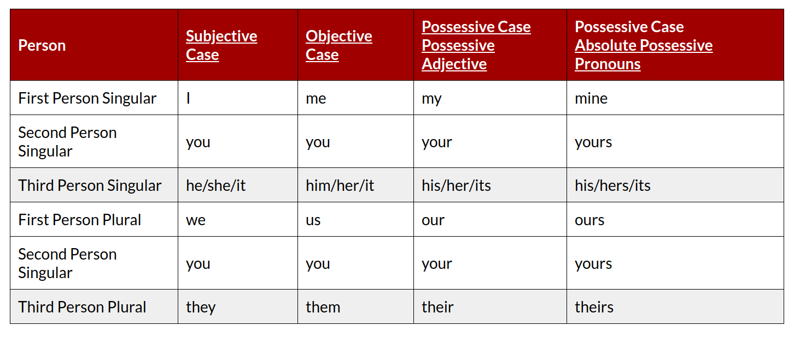
He is taller than me.
He is taller than I am.

Slide 4
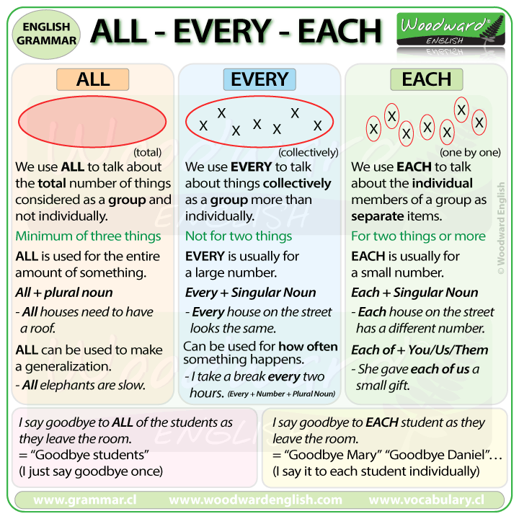

Slide 5
Nobody lives there.
Nobody live there.
Every country has a national flag.
All countries have a national flag.
Everybody needs to live in a society
Every soldier and every sailor has a rifle.
Each child has received a present.
Every person needs to work to lead a life

Slide 6
He is taller than me.
He is taller than I am.
Complement
He is a student.
Honey tastes sweets.
He is handsome.
He is poor.
No object here, they are called complement as it describes subject.

Slide 7
Linking words
However
We use ‘however’ and ‘nevertheless’ to express a contrast.
Usually, the first half of a sentence contrasts (opposes) the second half.
However is closer to ‘but’ and Nevertheless is closer to ‘in spite of’
Nevertheless emphasizes a stronger contrast than however.
Example
I already knew a lot about the subject; however, his presentation was still interesting.
I have already told on this topic. However, I am going to recapitulate once again what I told.
This is one solution to the problem. However, there are a number of others.
I'm a vegetarian. However, sometimes I eat fish.
I'm a vegetarian. Sometimes, however, I eat fish.

Slide 8
Nevertheless (তবুও)
Many know that too much sugar is bad for health. Nevertheless, many continue to eat a lot of it every day.
There are several serious problems with the car. Nevertheless, we will have to use it to drive to work this week.
Unless ( Condition or শর্ত )
The guard will not allow you to enter the theatre unless you show the ticket.
I will not go unless Peter gives my phone.

Slide 9
In addition
Players in Ac Milan are all good footballers. In addition, many of them have years of experience playing together.
He is kind, helpful and generous person. In addition, he is a sportsmen.
He is an popular actor. In addition, he often conducts program act as an anchor.

Slide 10
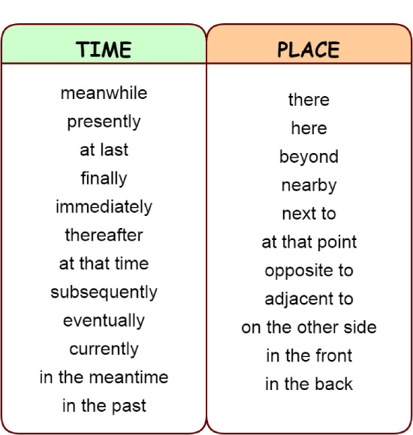

Slide 11
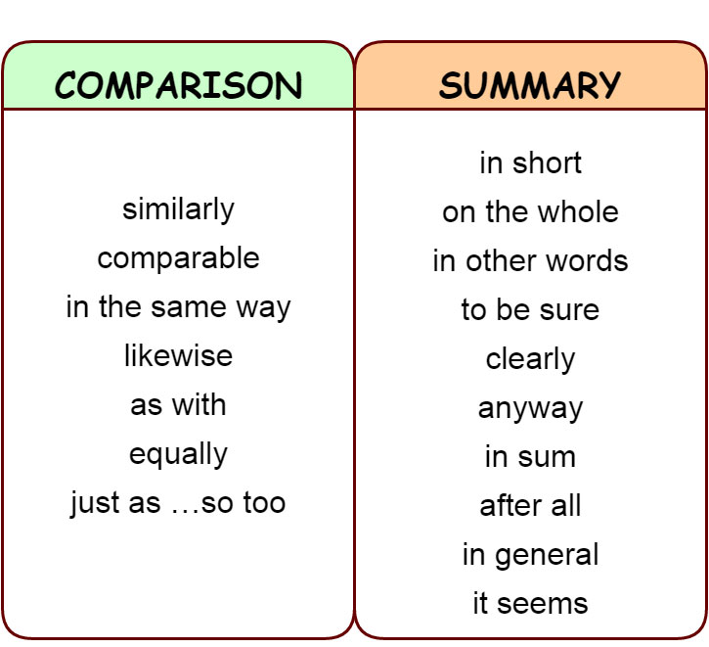

Slide 12
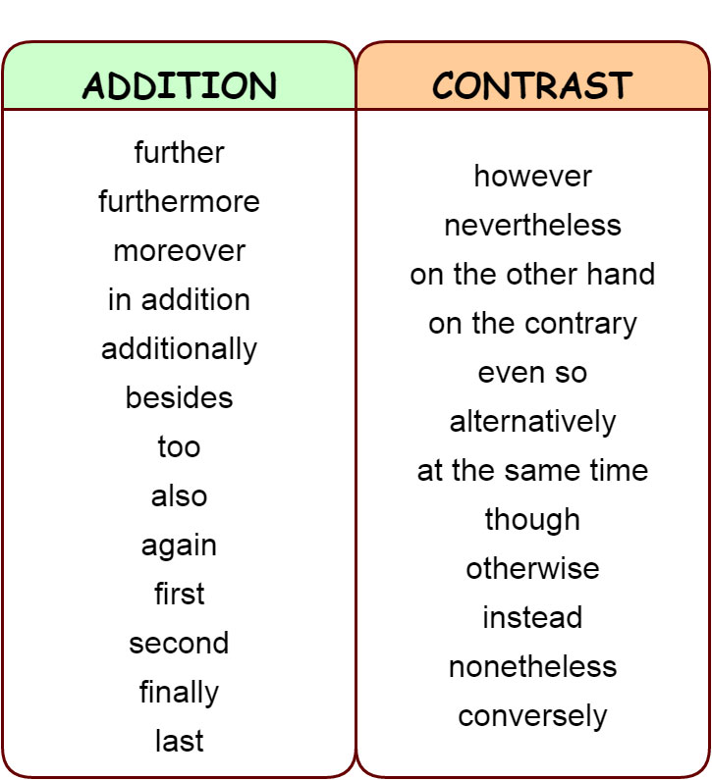

Slide 13
Phrasal Verb
1. Look after – Watch or protect; to keep safe
He look after his parents meticulously.
2. Look into – Investigate, explore, or consider
The college principal promised to look into the matter.
They set up a working party to look into the issue.
3. Look for = to search / to try to find
Peter is looking for a new job.
The detective is looking for clues to solve the case.

Slide 14
Article
Articles are words that define a noun as specific or unspecific.
Rule #1
we use a before words which begin with consonants (b,c,d,f…)
a doctor
a big car
a girl
When u makes the same sound as `you`
a uniform
a university
a used plate
'one' begin with consonants 'W'
a one-eyed monster
a one-rupee note
a used plate
Rule #2
We use an before words which begin with vowels (a,e,i,o,u)
an hour (`auer`)
an MA (em-a)

Slide 15
Rule #3
Use a or an only with countable nouns with singular form
Please give me a water.
Please give me some water.
Please give me a bottle of water.
Please give a advice.
Please give some advice.
A love. (Uncountable)
A happiness. (Uncountable)
A doctors. (Plural)
Rule #4
1.Use a or an to talk about a person or thing unknown to your listener
2. Use the talk about a person or thing known to your listener
My uncle has an antique car and a motorcycle. Even today, The car is very comfortable to drive and the bike seems almost intact.
Peter has a son. The boy wants to be an astronaut.
First introduce a noun with your listener then use the before a noun.

Slide 16
Rule #3
No article before a proper noun.
Chine, Dhaka, Zurich
However, there are some exceptions. A very few names of countries, which include words like republic and kingdom
1. the Ukraine
2. the Irish Republic
3. the Netherlands
4. the United States
5. the United Kingdom
6. the Middle East
7. the Arab world
8. the Bakans
9. the Baltics
10. the Philippines
Before names of things unique of their kinds
1. The sun,
2. The sky,
3. The sea,
4. The earth

Slide 17
Rule #3
Use a or an only with countable nouns with singular form
Please give me a water.
Please give me some water.
Please give me a bottle of water.
Please give a advice.
Please give some advice.
A love. (Uncountable)
A happiness. (Uncountable)
A doctors. (Plural)
Rule #4
1.Use a or an to talk about a person or thing unknown to your listener
2. Use the talk about a person or thing known to your listener
My uncle has an antique car and a motorcycle. Even today, The car is very comfortable to drive and the bike seems almost intact.
First introduce a noun with your listener then use the before a noun.

Slide 18
Tense
Present Simple or Indefinite
Hobby/
Routine/
Remain/Seems/
Like/Love/
Always/never/often/Usually/Every day
We use present simple for things that are true in general.
He goes to park on Sunday.
He likes tea.
I like coffee.
I love to play football
Peter lives in Dublin.
He works in a station.
He never goes to Cape Town.

Slide 19
Phrasal Verb
1. Look after – Watch or protect; to keep safe
He look after his parents meticulously.
2. Look into – Investigate, explore, or consider
The college principal promised to look into the matter.
They set up a working party to look into the issue.
3. Look for = to search / to try to find
Peter is looking for a new job.
The detective is looking for clues to solve the case.

Slide 20
He goes to school.
He goes to school regularly.
Peter swims with his friends.
Peter often swims with his friends.
Tom has a shower every morning.
The train arrives at 8:00 AM.
The train is arriving at 8.00 AM.
My friends is living in Havana.
My friends lives in Havana.
I am working as a teacher.
I work as a teacher.
Peter plays football regularly.
I sometimes go to office on foot.
It costs a lot of money to build a house.
Peter and Kevin are good friends.

Slide 21
Some verbs do not describe actions. These verbs are called
non-action or state verbs
I am wanting ice-cream.
I am liking tea.
I am drinking tea every morning.
I drink tea every morning.
I am listening to a bird singing.
I am hearing a bird singing.
He goes to school.
He goes to school regularly.
Peter swims with his friends.
Peter often swims with his friends.
Tom has a shower every morning

Slide 22
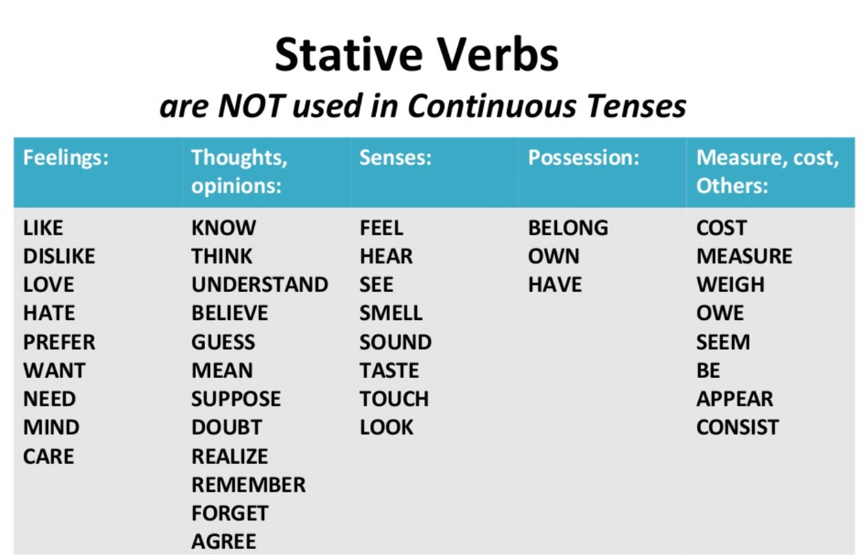

Slide 23
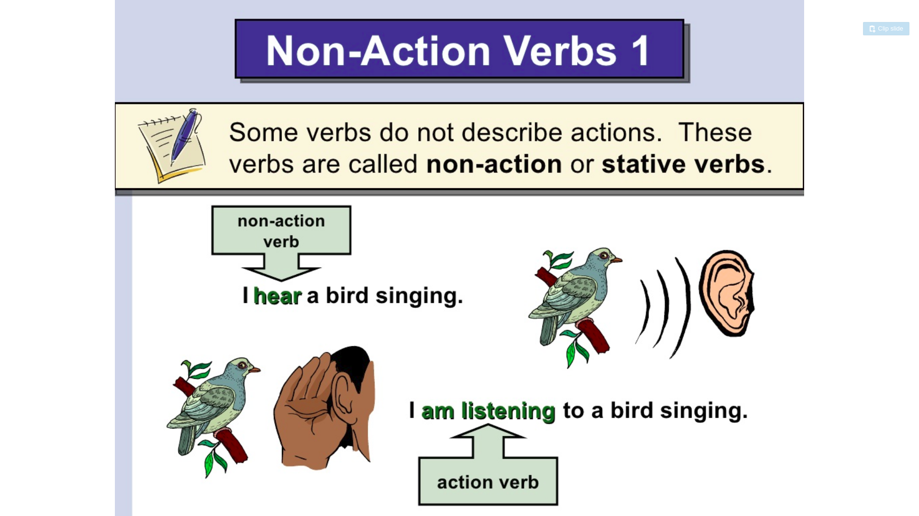

Slide 24
Present Continuous
Now, At the moment time of speaking or doing
Structure = Subject + am/is/are/was/were + Verb-ing
The phone is ringing.
He is listening to me..
It is raining.
The baby is crying.
We are having party next weekend.
I am going to buy some books tomorrow.
Sarah is going to sell her car.
I am going to watch TV this evening.
Tom is working today.
Rabia is going to phone later (Sure)
Rabia might phone later. (Possible)

Slide 25
Do not use these verbs in present continuous
Like
Love
Want
Know
Understand
Remember
Depend
Prefer
Need
Mean
Forget
Believe
Mean

Slide 26
Present Perfect
Action is important than the time.
Something happened in past but we don’t know when it happened
I have a bought a house.
When did you it?
I bought it last week.
I bought a house few weeks ago.
I bought a house yesterday.
I bought a house a few seconds ago.
I bought a house in February.
I bought a house in 2010.
I have been to Australia.

Slide 27
If the past time is important then use past simple.
If the time is not important then use present perfect.
Just
Recently.
Time does not mention exactly, on that case use present perfect.
Talking about unfinished state.

Slide 28
Present Perfect Continuous
Action that started in the past and are still continuing.
Form: Subject + have/has + been + verb (-ing)
I have been doing this job for last 2 years.
I have been living in here since 2000.
He has been playing tennis since his childhood.
I have been waiting for doctors for 2 hours.

Slide 29
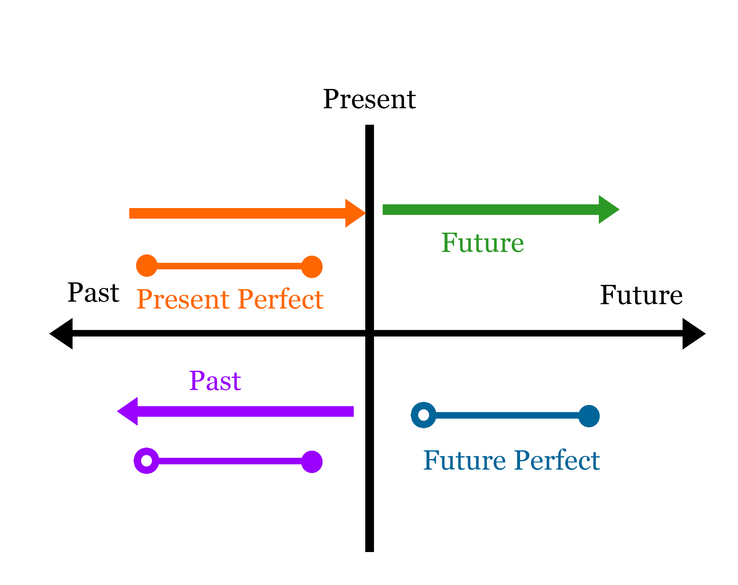

Slide 30
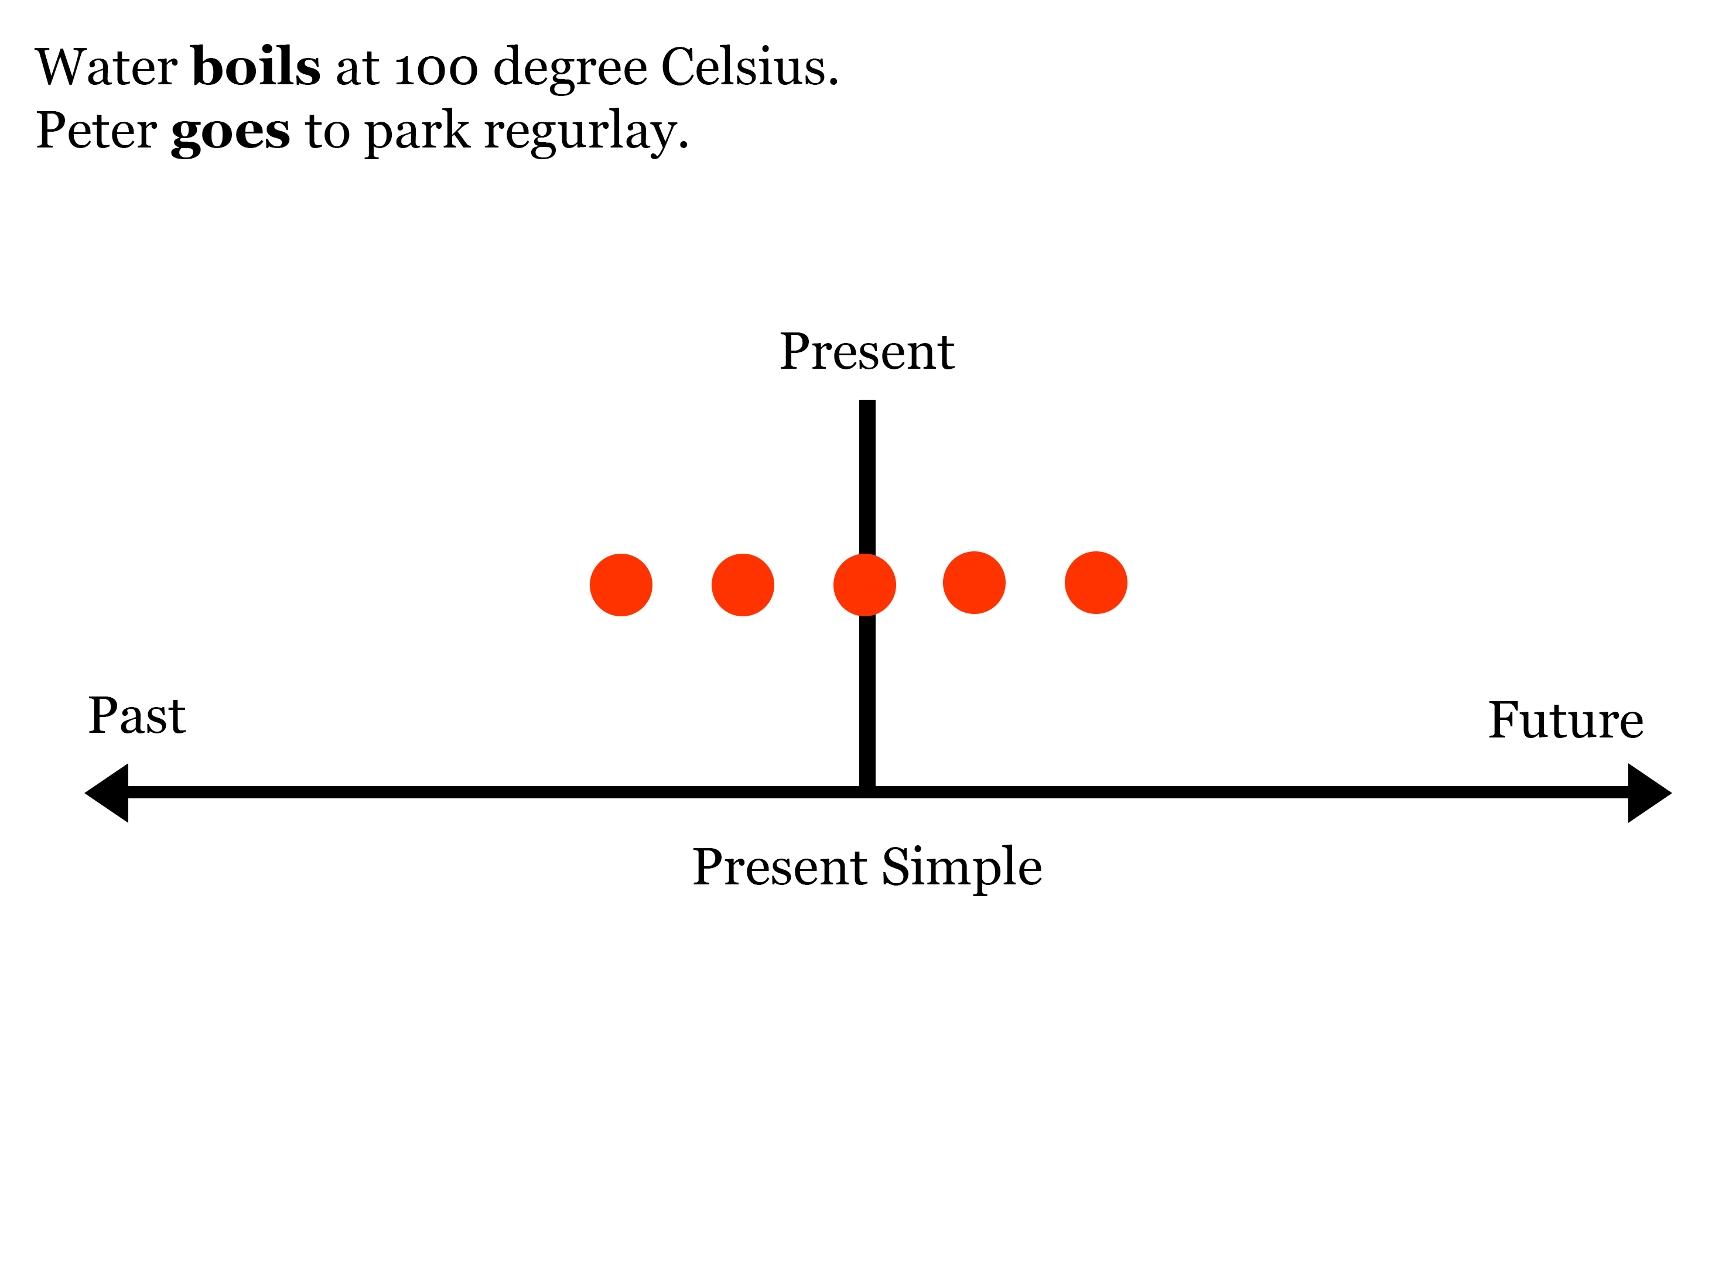

Slide 31
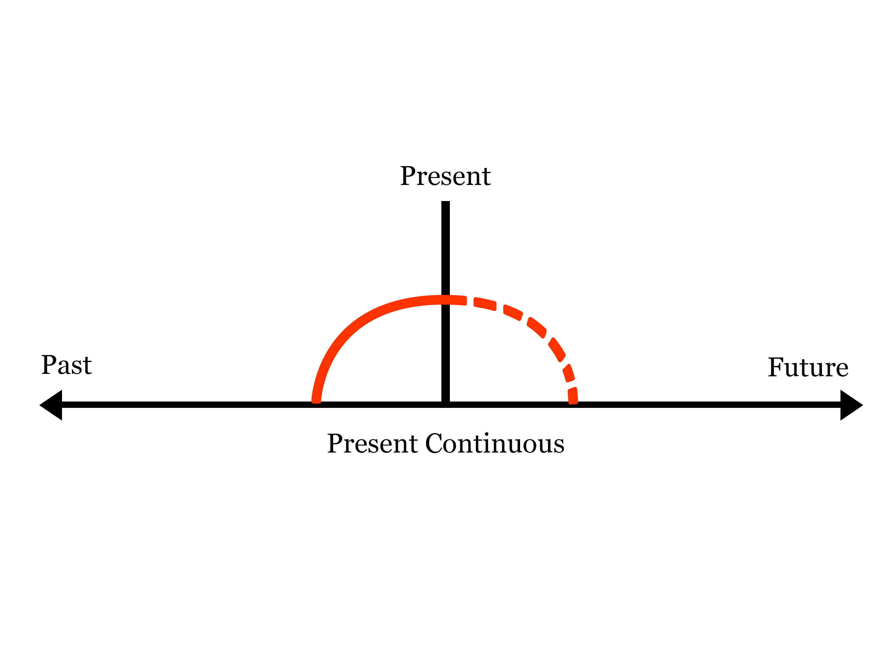

Slide 32
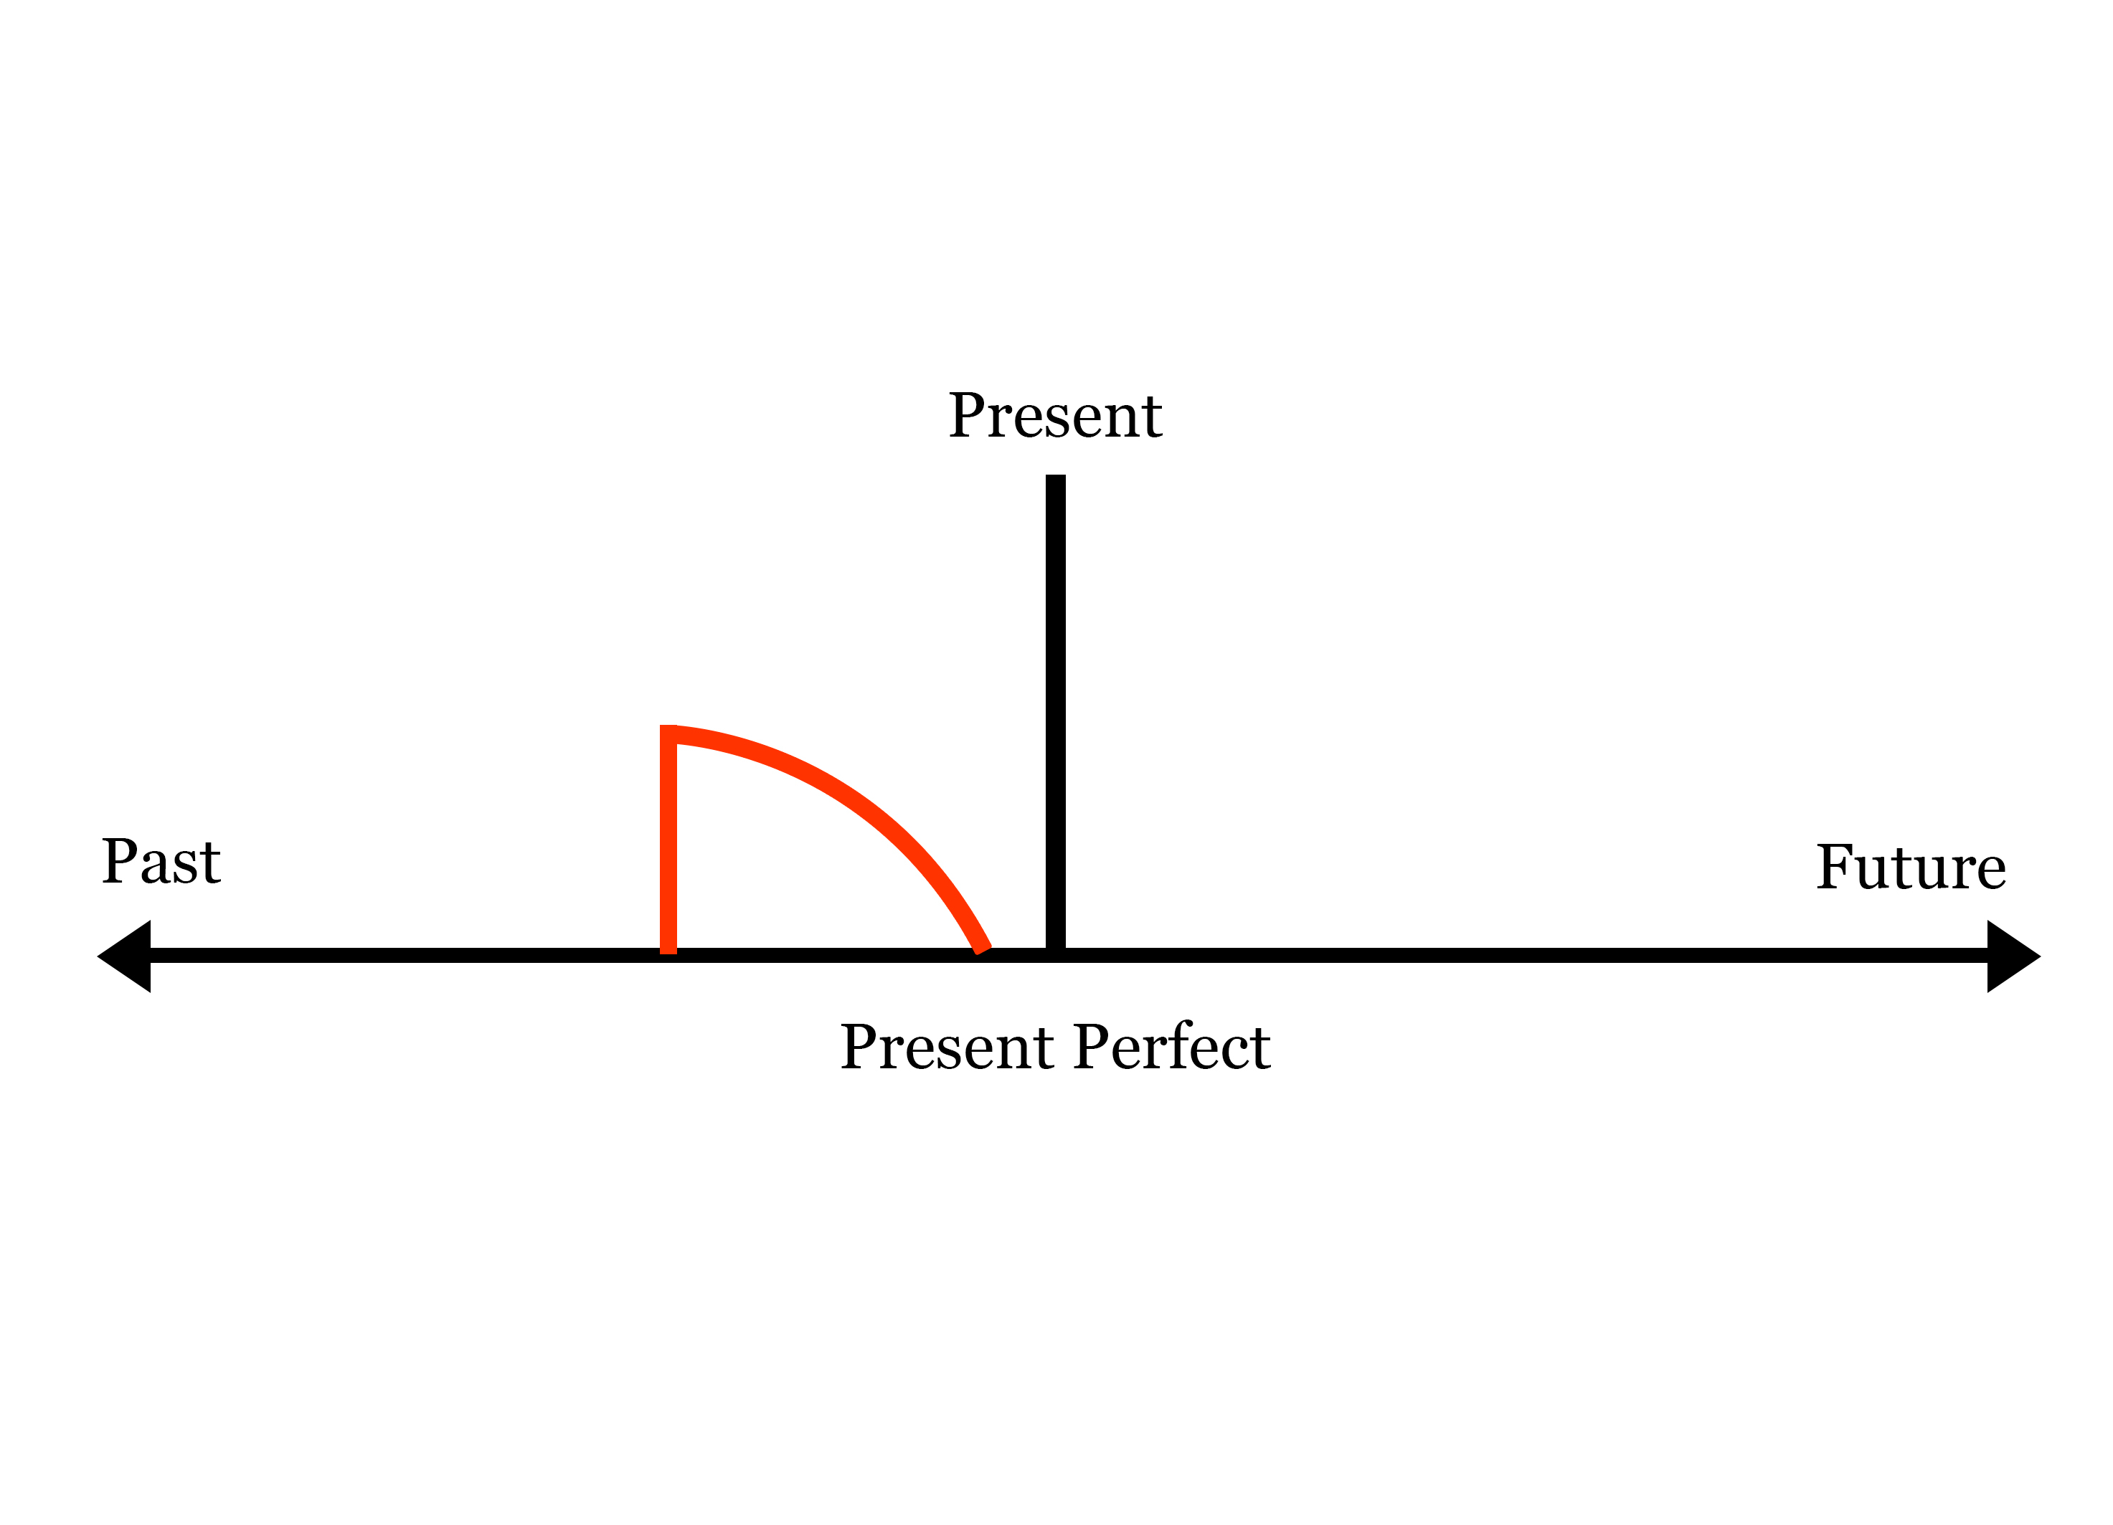

Slide 33
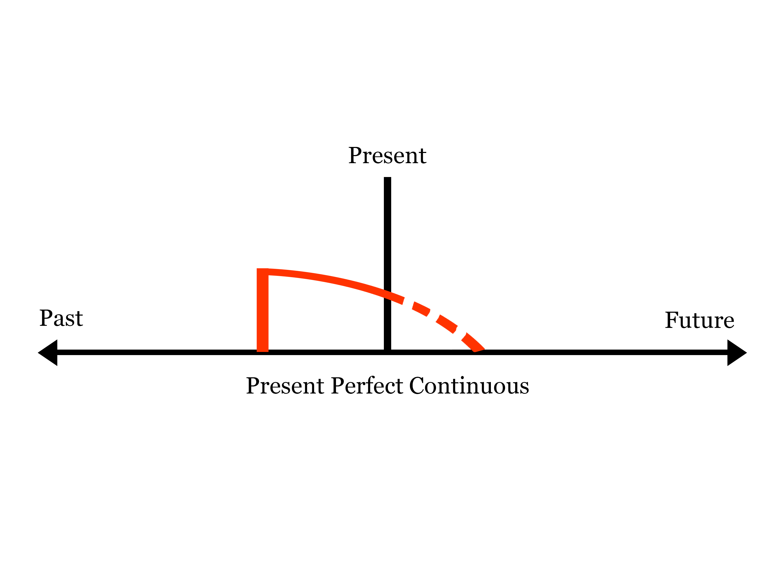

Slide 34
Past Simple
An action which happened in past and finished.
I was a student.
I bought a car.
I bought a car in 2014.
I have bought a car yesterday.

Slide 35
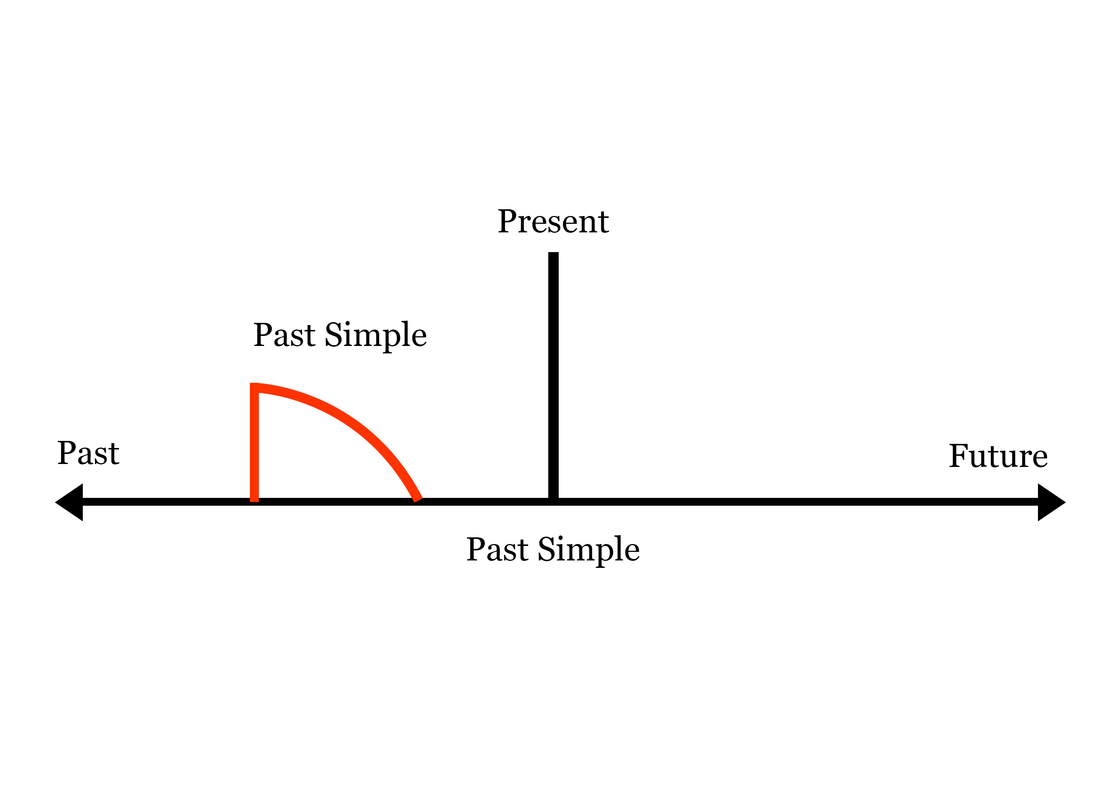

Slide 36
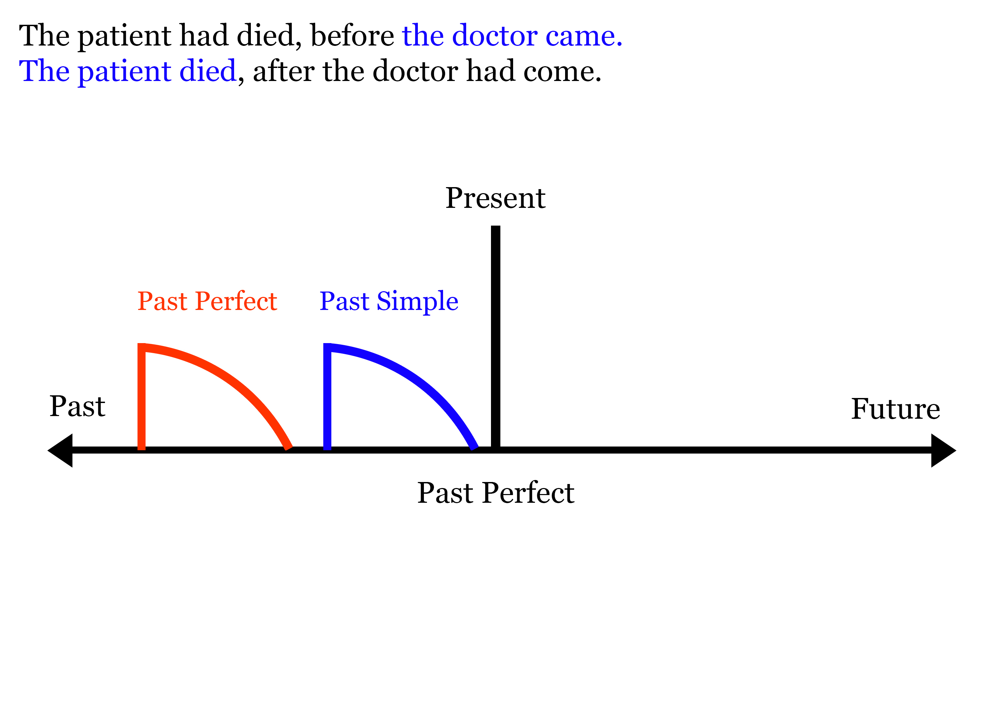

Slide 37
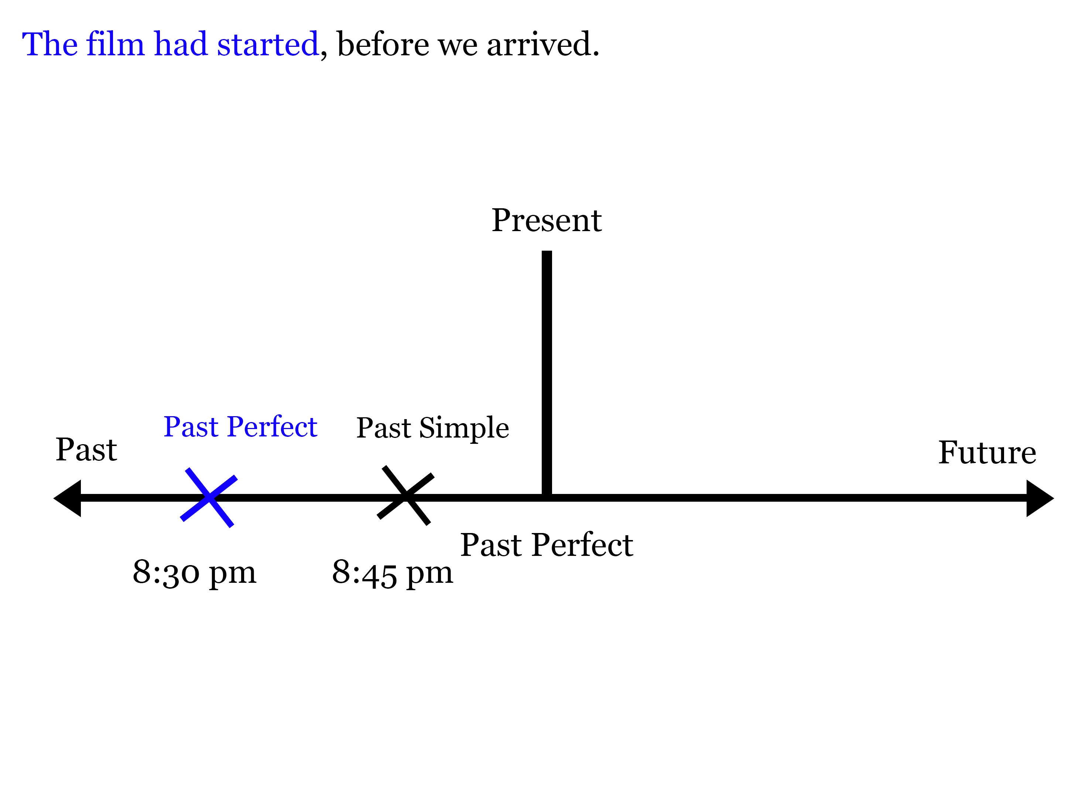

Slide 38
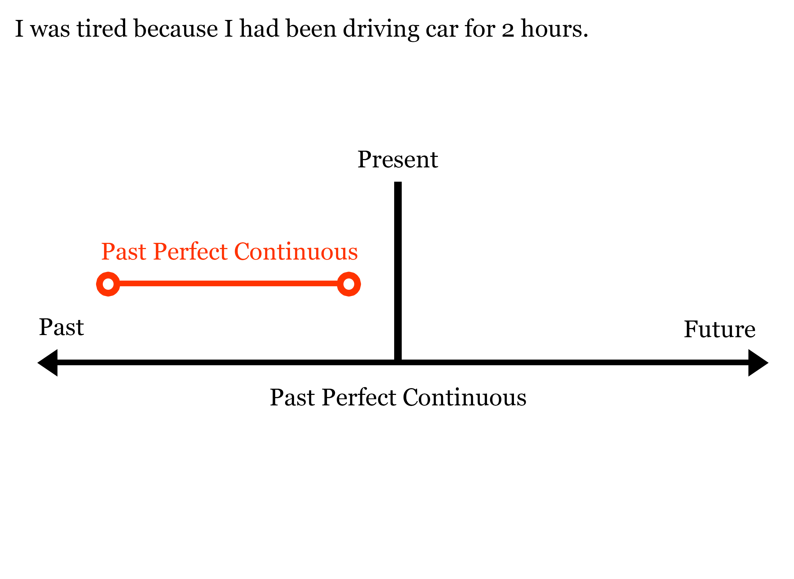

Slide 39
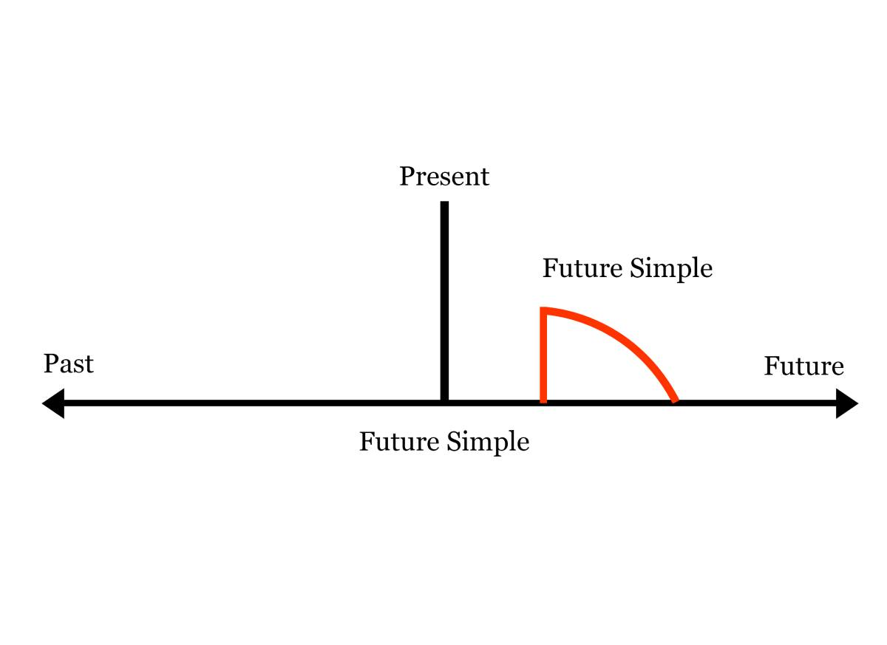

Slide 40
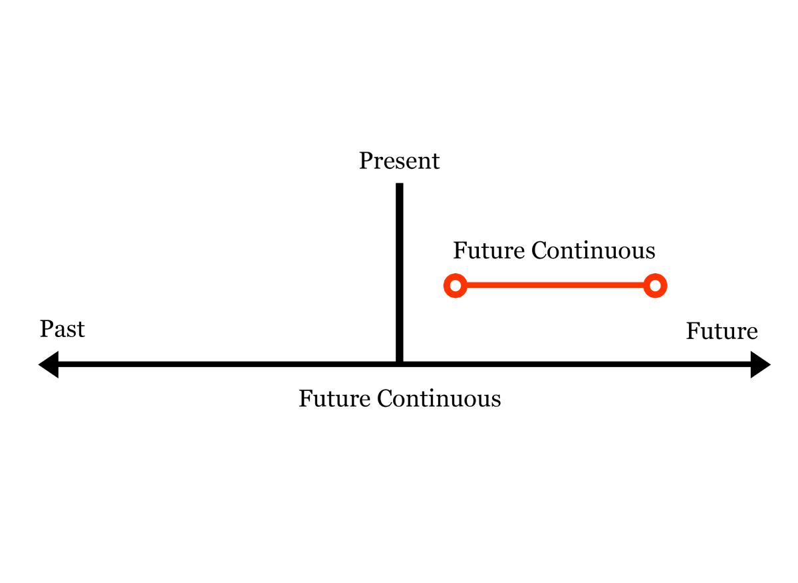

Slide 41
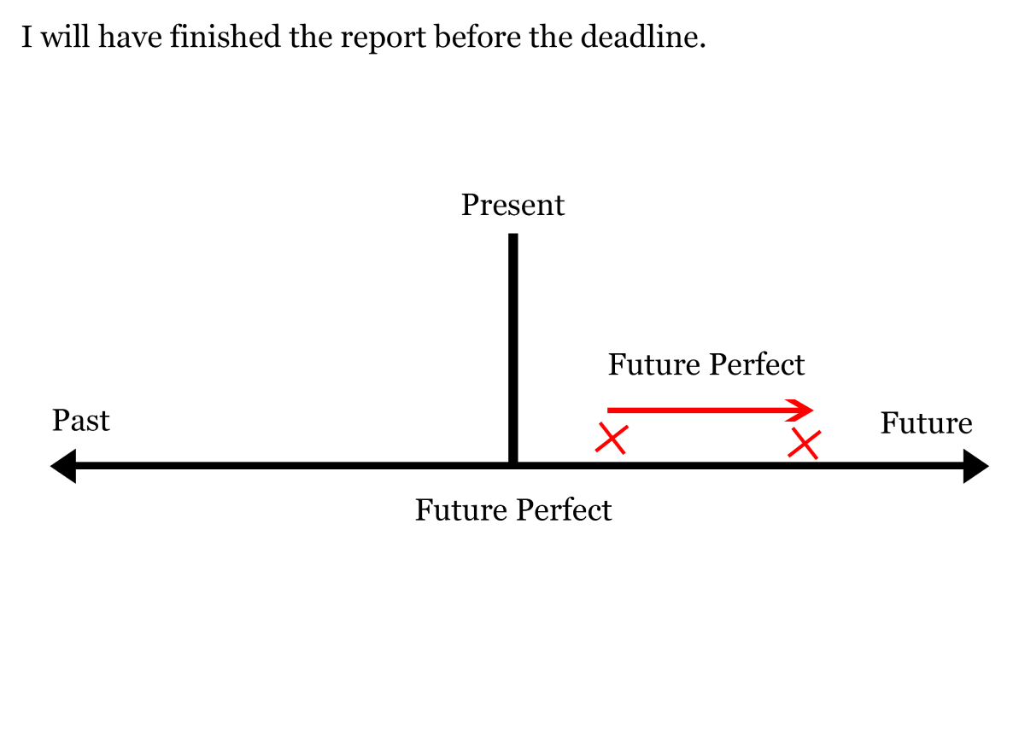

Slide 42
Past Simple
An action which happened in past and finished.
I was a student.
I bought a car.
I bought a car in 2014.
I have bought a car yesterday.
I have bought a car a few seconds ago.
I bought a car few seconds ago.
I played football with my friends last Sunday.
Peter lived in Canada for 5 years.

Slide 43
Past Continuous
Unfinished, Ongoing action in the past also mention a finished action in the past.
I was having dinner with my family when door bell rang.
It was raining when Julia left for work.
The power went out when children were studying.
While we were waiting at the bus stop, we saw a car accident.

Slide 44
Past Perfect
Unfinished, Ongoing action in the past also mention a finished action in the past.
I was sick because I had eaten too much the previous night.
The man looked very familiar. I had seen him somewhere before.
The doctor arrived, after the patient had died.
Past perfect and past simple together use in a past story.

Slide 45
Past Perfect Continuous
Form: Subject + had been + verb (-ing)
The first ( continuous ) past action
1. I felt really tired because I had been driving all day.
2. She had been waiting for two hours when doctor finally arrived.
3. When the phone rang, I had been washing the dishes for half an hour.

Slide 46
Past Perfect Continuous
Form: Subject + had been + verb (-ing)
The first ( continuous ) past action
1. I felt really tired because I had been driving all day.
2. She had been waiting for two hours when doctor finally arrived.
3. When the phone rang, I had been washing the dishes for half an hour.

Slide 47
Future Simple
Simple future has two different forms in English: "will" and "be going to." they often express two very different meanings.
Structure
1. Subject + am/is/are + verb (base)
2. Subject + to be going to + verb (base)
Going to — plans and Intentions
1. We are going to buy a new car. (plan)
2. Hasan is going to take a vacation from work. (plan)
3. You are going to meet Jane tonight.
Going to vs Present continuous
We are going to get married this year. (Plan: Future Simple)
We are getting married on 20th April. (Fixed arrangement : present continuous)

Slide 48
Shall/Will --------------- Offer, Promise, Instant decisions, Make predictions
I think Spain will win the 2022 World Cup.
It will rain tomorrow.
I'll pay for the tickets by credit card.
You will do exactly as I say.

Slide 49
Future Continuous
Structure
1. Subject + shall-will + be + verb (-ing)
Ongoing actions in the future
1. At 11:00 a.m tomorrow, I shall be driving to Portland.
2. I will be staying at the hotel in Portland.

Slide 50
Future Perfect Continuous
Structure
1. Subject + will have + be + verb (past participle / V3)
By December, Peter will have saved $1200.

Slide 51
Sentence
Sentence are 3 kinds in terms of structure
1. Simple Sentence
2. Compound Sentence
3. Complex Sentence
Simple Sentence:
One subject and one finite verb.
I am a doctor.
Peter is reading a book.
It’s another name is independent clause.

Slide 52
Compound Sentence:
It has two or more independent clause.
Kevin is a doctor. His wife is a teacher.
Kevin is a doctor, and his wife is a teacher.
He did no have enough cash, so he paid by credit card.
You should study properly, or you will fail.
Two sentence connected with coordinating conjunction like
F = for
A = and
N = nor
B = but
O = or
Y = yet
S = so

Slide 53
Complex Sentence:
A complex sentence has one independent clause and a dependent clause
When I get home from work, = Dependent clause
I usually watch TV = Independent clause.
When I get home from work, I usually watch TV.
Let me know if you need any help.

